Slide 1
Pretty Good Privacy
Pretty Good Privacy (PGP) refers to a cryptographic program designed to protect the privacy of confidential emails against hackers and unintended recipients.
Email is a prime attack method for cyber criminals who can easily forge messages using a victim’s name or identity. PGP aims to solve this and enhance email security by encrypting the data to make the communication method more private.
The data encryption program provides cryptographic authentication and privacy for data used in online communication. This allows PGP to be used for encrypting and decrypting text messages, emails, and files.
Services provided
Authentication
Confidentiality
Digital Signature
Email Compatibility
Zip (Compression algorithm)

Slide 2
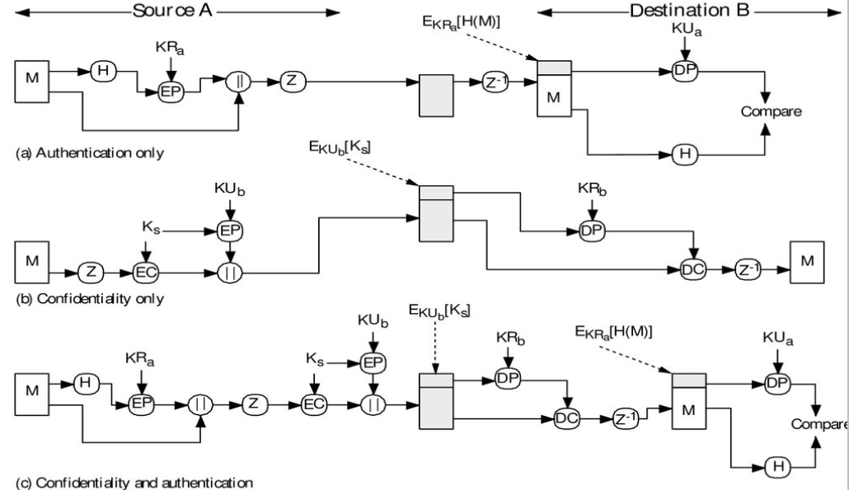








Slide 3
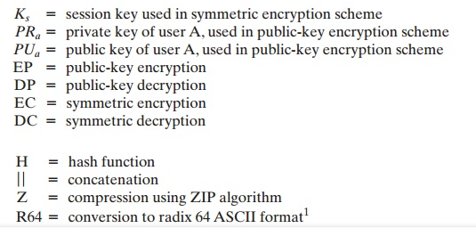

Slide 4
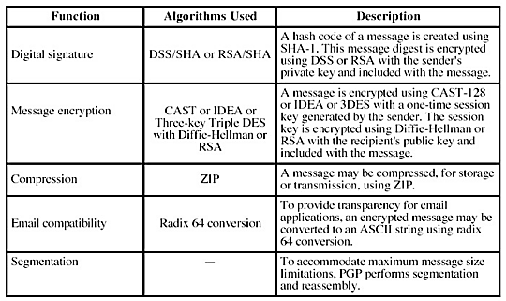

Slide 5
Advantages
PGP compresses the message after applying the signature but before encryption. This has the benefit of saving space both for e-mail transmission and for file storage.
Sensitive information is always protected. It cannot be stolen or viewed by others on the internet. It assures that the information that is sent or received was not modified in transmission and that files were not changed without your knowledge.

Slide 6
Kerberos
Kerberos is one of the authentication application.
It is implemented in client server architecture.
Before the communication starts, the client should be authenticated by the server and the server should be authenticated by the client.
After authentication on both sides, the client will send the request and the server will provide the service.

Slide 7
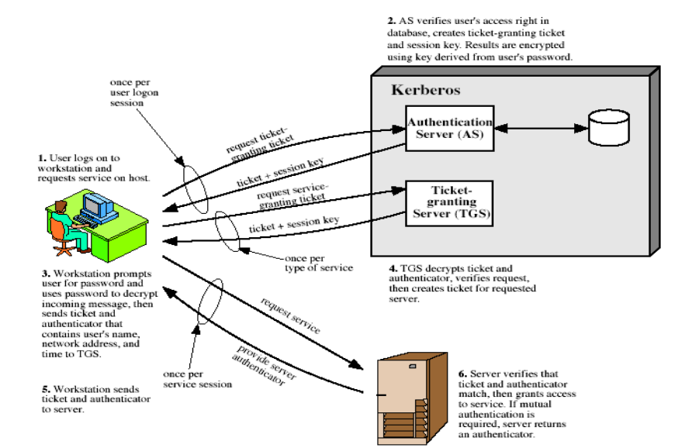

Slide 8
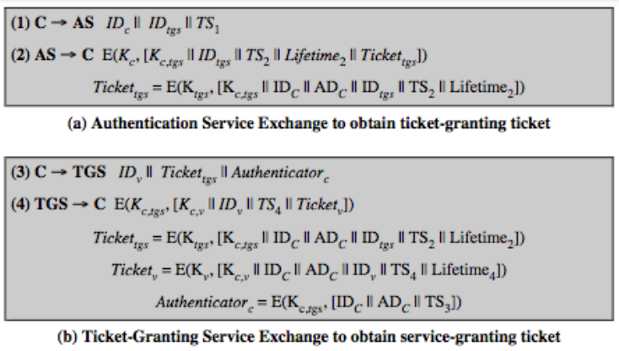
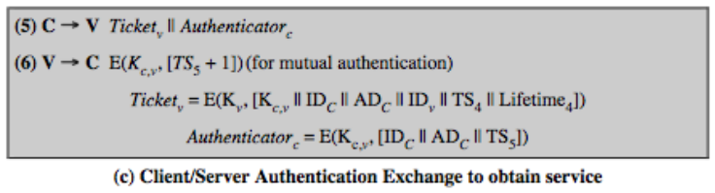

Slide 9
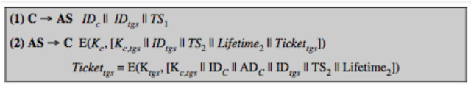
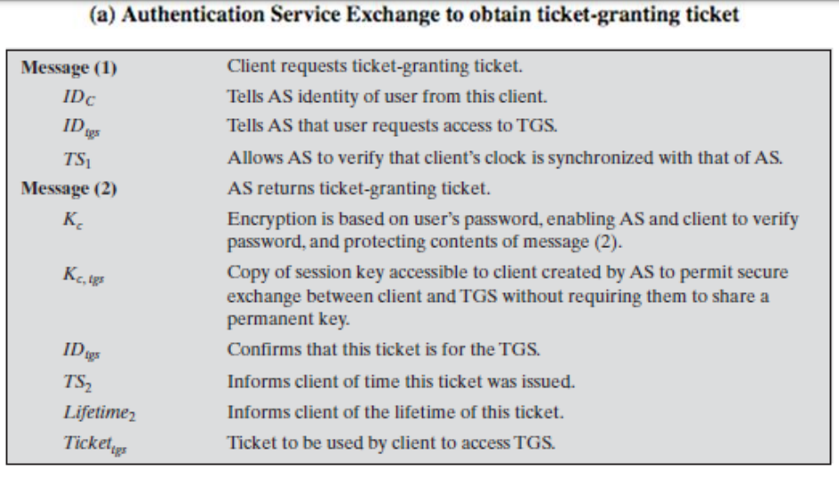

Slide 10
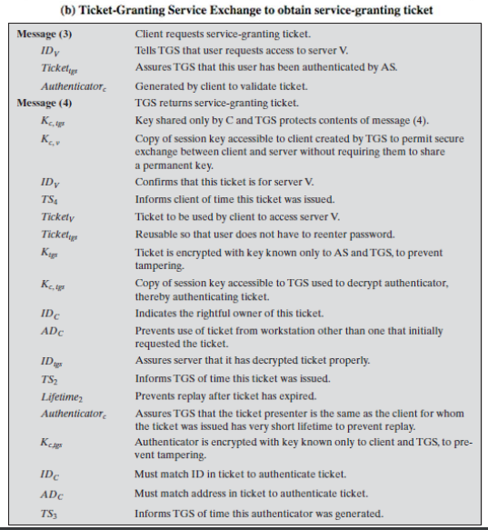
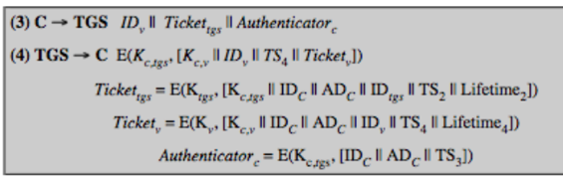

Slide 11
